Slide 1
Empirical PIDdling
ECE5
J Eldon

Slide 2
Setting PID
For small, low torque motors with little or no gearing,
For baseline tune, probe response to a disturbance.

Slide 3
Steps to tune PID
Set all gains to zero.
Increase P until response to a disturbance is steady oscillation.
Increase D until oscillations go away
  (critically damped)

Slide 4
Rinse and repeat
Repeat steps 2 and 3 until increasing D does not stop the oscillations.
Set P and D to the last stable values.

Slide 5
“That’s Eye-Gain”
https://www.youtube.com/watch?v=nxxSIX3fmmo
Increase I until it brings you to the setpoint with the number of oscillations desired
  Normally zero but a quicker response can be had if you don't mind a couple oscillations of overshoot.

Slide 6
Disturbance in the Force
Disturbance you use depends on the mechanism the controller is attached to.
Normally move the mechanism by hand away from the setpoint and let go
  Oscillations grow bigger → reduce P
If you set D too high the system will chatter
  vibrate at a higher frequency than the P oscillations
  Reduce D until oscillation stops.

Slide 10
Damping
Over
Under
Critical = Goldilocks (Baby Bear)

Slide 11
Unforced harmonic oscillator
ma + bv + kx = 0
a = d²x/dt² v = dx/dt
m > 0, b ≥ 0, k > 0
characteristic equation:
ms² + bs + k = 0
characteristic roots:
( -b ± √b2 - 4mk ) / 2m

Slide 12
Root of Damping
b2 < 4mk: underdamping, b is small wrt m*k
b2 > 4mk: overdamping, b is large wrt m*k
b2 = 4mk: critical damping, between over and underdamping.

Slide 13
Underdamping
non-real complex roots because sqrt (negative)
use roots to solve equation
Let ω_{d} = SQRT(b²-4mk)/2m.
characteristic roots: -b/2m ± iωd
complex exponential solutions

Slide 14
Underdamping, continued
e^{(-b/2m+iωd)t}, e^{(-b/2m-iωd)t}
The real solutions are:
e^{-bt/2m} cos(ωdt) and e^{-bt/2m} sin(ωdt)
General real soln:
x(t) = c₁e^{-bt/2m} cos(ωdt) + c₂e^{-bt/2m} sin(ωdt)
= Ae^{-bt/2m} cos(ωdt - φ)

Slide 15
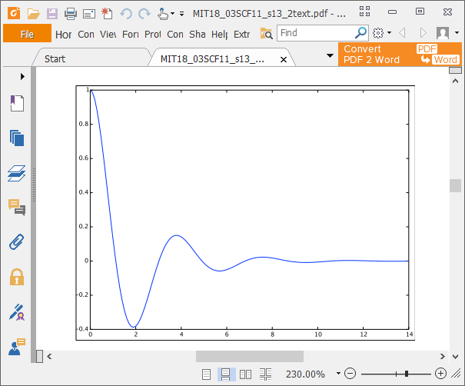
Underdamping

Slide 16
What it all means
b=0 ➔ sinusoid
b>0 ➔ damped sinusoid
  has pseudofrequency, which decreases

Slide 17
Overdamping
b2 > 4mk
➔ term under square root > 0
➔ characteristic roots negative real
and unequal

Slide 18
Overdamping, continued
Characteristic roots:
r₁ = (-b+SQRT(b²-4mk))/2m
r₂ = (-b-SQRT(b²-4mk))/2m
Exponential solutions: exp(r₁t), exp(r₂t)
General solution:
x(t) = c₁exp(r₁t) + c₂exp(r₂t)
Large damping prevents oscillation
  typical on spring return on doors

Slide 19
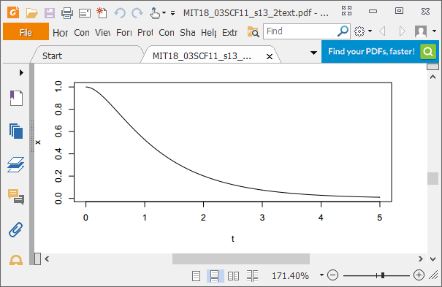
Overdamping

Slide 20
Critical Damping
Both roots = -b/2m
Solutions = e^{-bt/2m} and te^{-bt/2m}
x(t) = e^{-bt/2m} (c1 + c₂t)
fastest return to equilibrium

Slide 21
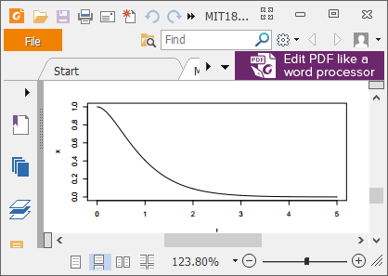
Critical Damping

Slide 22
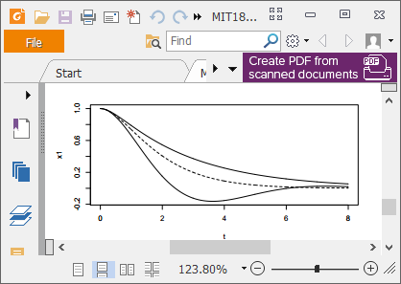
Comparison

